Slide 1


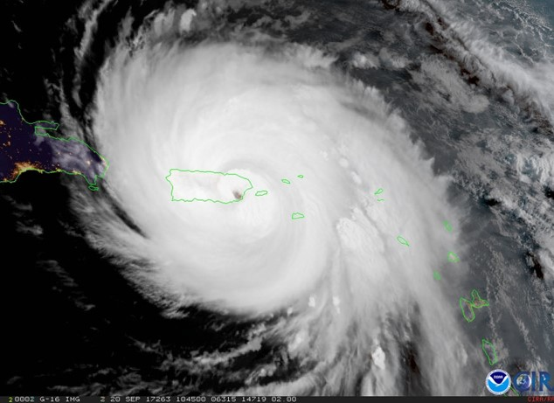
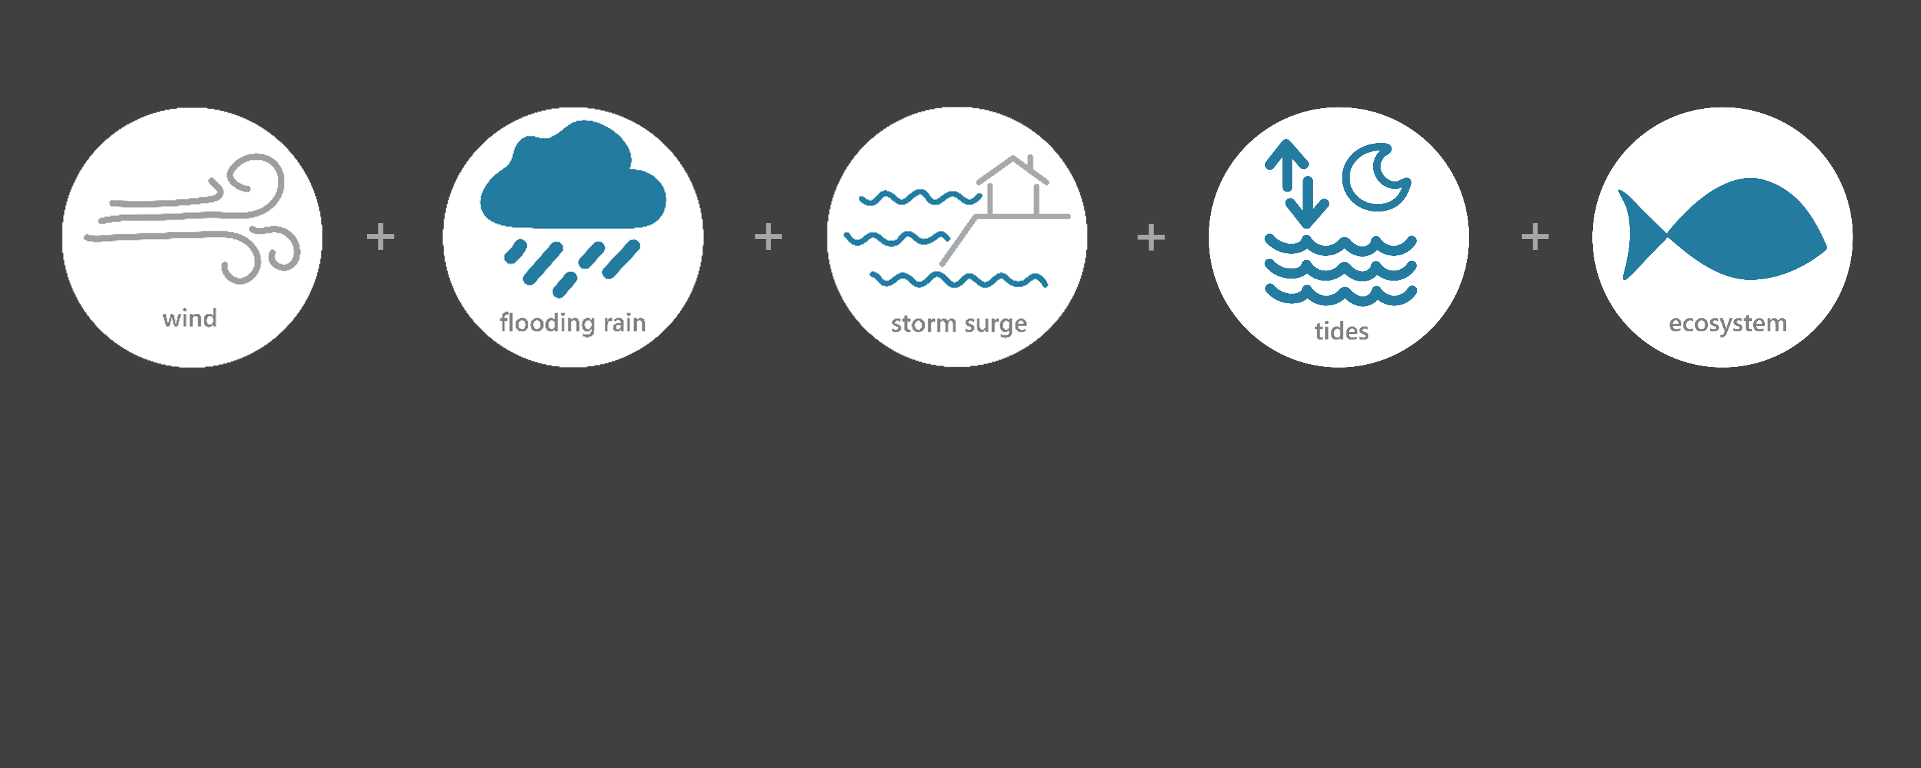

[ SEP 18 – SEP 24, 2017 ]
HURRICANE MARIA
4
Category
(catastrophic)
6.9
Inches of Rain
63.3
Miles per hour
of Max Wind Speed
3.8
Feet of Storm Tide*
Monitoring the Impact of Hurricane Maria at “Jobos Bay NERR”
Hurricane Maria was a very severe storm that ravaged islands in the Caribbean Sea. After devastating the island of Dominica as a category 5 hurricane, it reached Puerto Rico with intensities near the high-end of category 4. Extreme winds and massive floods destroyed much of Puerto Rico. NOAA estimates Maria caused around $90 billion in damages in Puerto Rico and the U.S. Virgin Islands, making it the 3rd costliest hurricane in U.S. history.
The effects of Maria were observed at the Jobos Bay NERR (JBNERR) Research Reserve through the System-Wide Monitoring Program (SWMP), which tracks short-term variability and long-term change of weather and water quality in the areas surrounding the southern coast of Puerto Rico.
Data shown are based on the JBNERR weather monitoring site
*USGS Storm Tide Sensor at Jobos Bay
Created on May 17, 2022

Slide 2

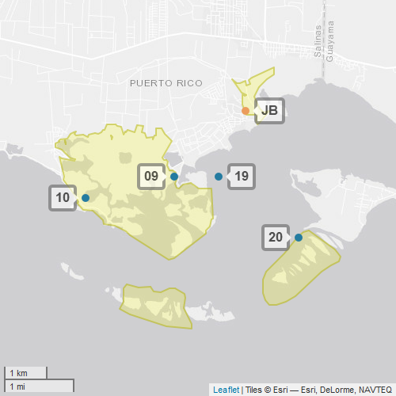
JBNERR
Jobos Bay NERR (JBNERR) is one of 29 sites in the National Estuarine Research Reserve Systems (NERRS). Each site is a state-federal partnership that combines research, monitoring, and education to advance the understanding and management of estuarine environments.
NERRS
Centralized Data
Management Office
JBNERR
JBNERR Storm Monitoring
JBNERR operates a weather station located at Jobos Bay (JB) and maintains four continuous, long-term water quality stations including Station 9, Station 10, Station 19, and Station 20. JBNERR is part of the SWMP. As Hurricane Maria approached Puerto Rico, JBNERR monitored the weather and water quality, collecting data every 15 minutes for the following parameters: air temperature, relative humidity, atmospheric pressure, rainfall, wind speed and direction, water temperature, depth, salinity, dissolved oxygen, turbidity, and pH.
Weather Station
Water Quality Sample Location

Slide 3
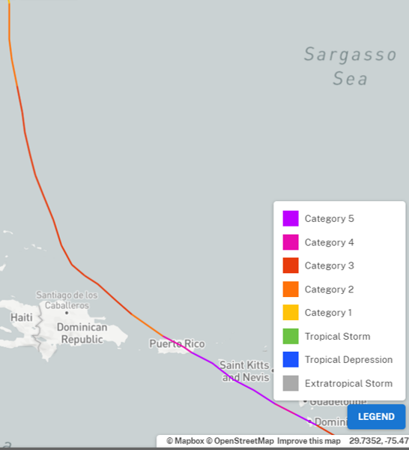
Maria strengthened extremely rapidly as it neared Dominica and became a category 5 hurricane. Maria made landfall on the island on Sept. 19. It continued moving and reached peak intensity 25 n mi south of St. Croix on Sept. 20. Afterwards, Maria made it to Puerto Rico as a category 4 hurricane later that same day.
Puerto Rico experienced devastating winds and storm surges that resulted in record flooding. Hundreds of families had to rescued from their rooftops. Essentially all of the island’s 3.4 million residents lost power. Practically all cell phone service was lost and municipal water supplies were knocked out.
Source: https://oceanservice.noaa.gov/news/historical-hurricanes/
Maria was a Category 4 on the Saffir–Simpson scale when it made landfall along the southeastern coast of Puerto Rico. Maria’s intensity reduced just below the threshold of category 4 and at the same time grew in size prior to reaching the island.
Buildings, homes, and roads along the east and southeast costs were destroyed. Marinas and harbors were severely damaged due to storm surge. Maria knocked down 80 percent of Puerto Rico’s utility poles and all transmission lines.
Aquatic life (i.e., oysters, crabs, fish, aquatic plants, phytoplankton) rely on specific levels of salinity and dissolved oxygen to thrive and survive. The water quality in the reserve was impacted by Maria with significant drops in salinity levels and dramatic changes to the typical diurnal variation of dissolved oxygen. These shifts potentially stressed organisms in the area.
JBNERR
Station | Date | Rainfall Total (in) | Barometric Pressure Average (mB) | Wind Speed Max (mph) | Wind Speed Average (mph)
Jobos Bay Weather | 9/19/2017 | 0.38 | 29.8 | 21.0 | 6.6
Jobos Bay Weather | 9/20/2017 | 3.00 | 29.3 | 63.3 | 33.9
Jobos Bay Weather | 9/21/2017 | 1.89 | 29.7 | 31.8 | 20.5
Jobos Bay Weather | 9/22/2017 | 0.21 | 29.8 | 21.3 | 15.0
Jobos Bay Weather | 9/23/2017 | 1.14 | 29.8 | 22.1 | 10.1
The highest local rainfall and wind measurements were recorded when Maria made landfall and crossed the island on Sept. 20.
Data reporting time periods for Hurricane Maria: 9/19/2017 - 9/23/2017

Slide 4
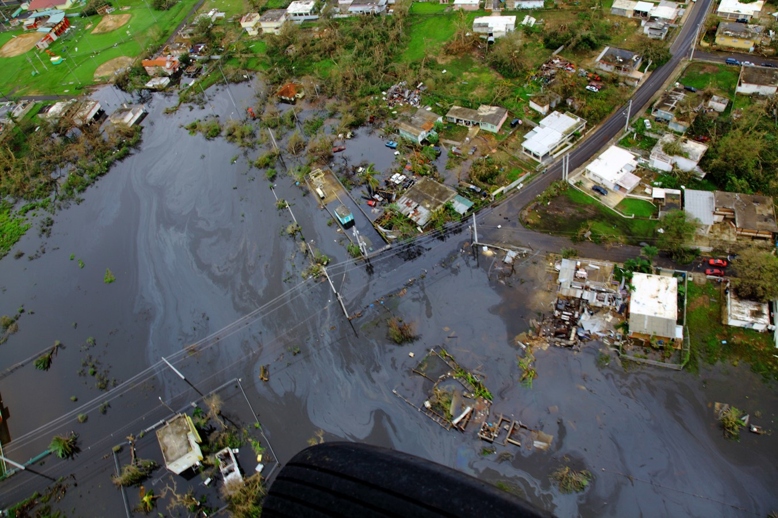
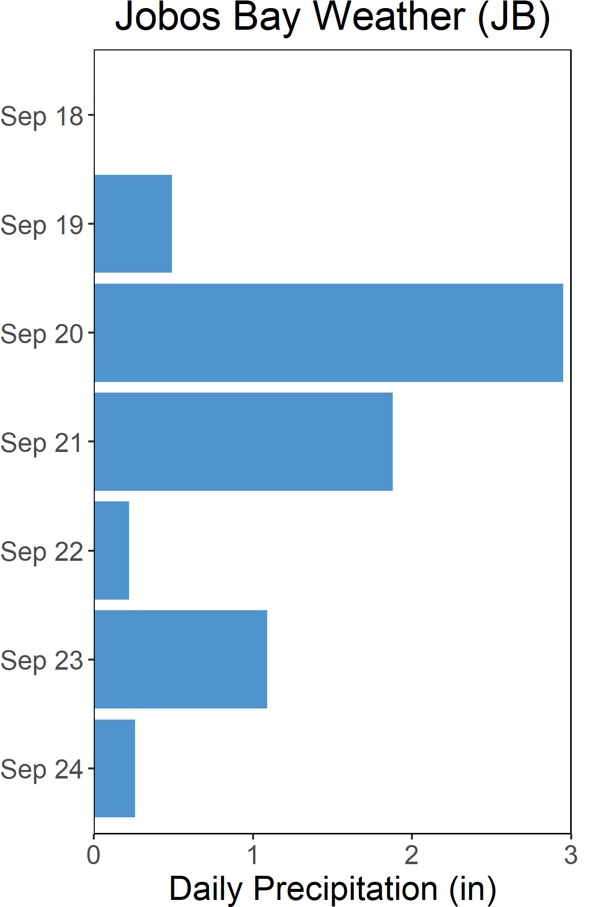
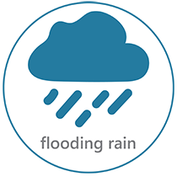
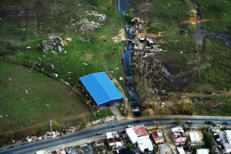
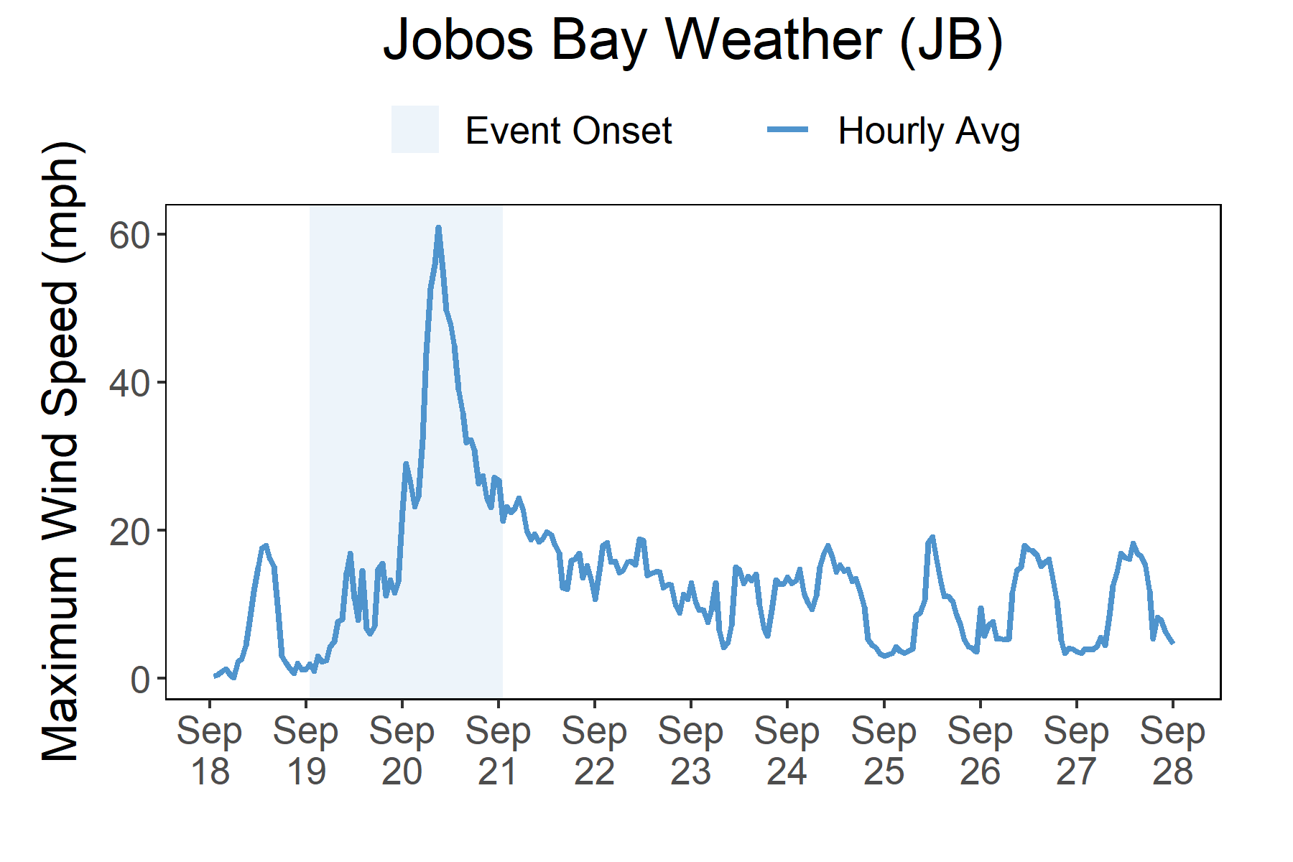

Rainfall
A total of 6.9 inches of rainfall fell in the reserve area over the course of a week.
Maria brought heavy rains and storm surge flooding to Puerto Rico.
Impacts to Puerto Rico from Hurricane Maria resulted in property damage, street flooding, power outages, and mud slides. Heavy rains fell over Puerto Rico with 6.9 total inches of rainfall recorded at the Jobos Bay weather station. In areas along the northeastern and southeastern coasts of Puerto Rico, maximum inundation levels of 3 to 5 ft above ground level occurred. The USGS Storm Tide Sensor in Jobos Bay recorded a storm tide of 3.84 ft. The maximum wind speed recorded at Jobos Bay weather station was 63.3 mph.
Maria is the strongest hurricane to make landfall in Puerto Rico since a category 5 hurricane in 1928 (known as Segundo San Felipe). When Maria’s center crossed the southeast coast of Puerto Rico, the hurricane’s maximum winds were near 135 kt which is just below the threshold of category 5. Despite Maria’s designation as a category 4 hurricane as it crossed the island, winds of category 5 intensity were almost certainly felt at some elevated locations on the island.
Rainfall measurements at the Jobos Bay weather station from Sept. 18 through Sept 24.
Wind Speed
Max wind speed recorded at the reserve was 63 mph on Sept. 20.
Maximum Wind Speed readings at the Jobos Bay weather station from Sept. 18 through Sept. 28.

Slide 5
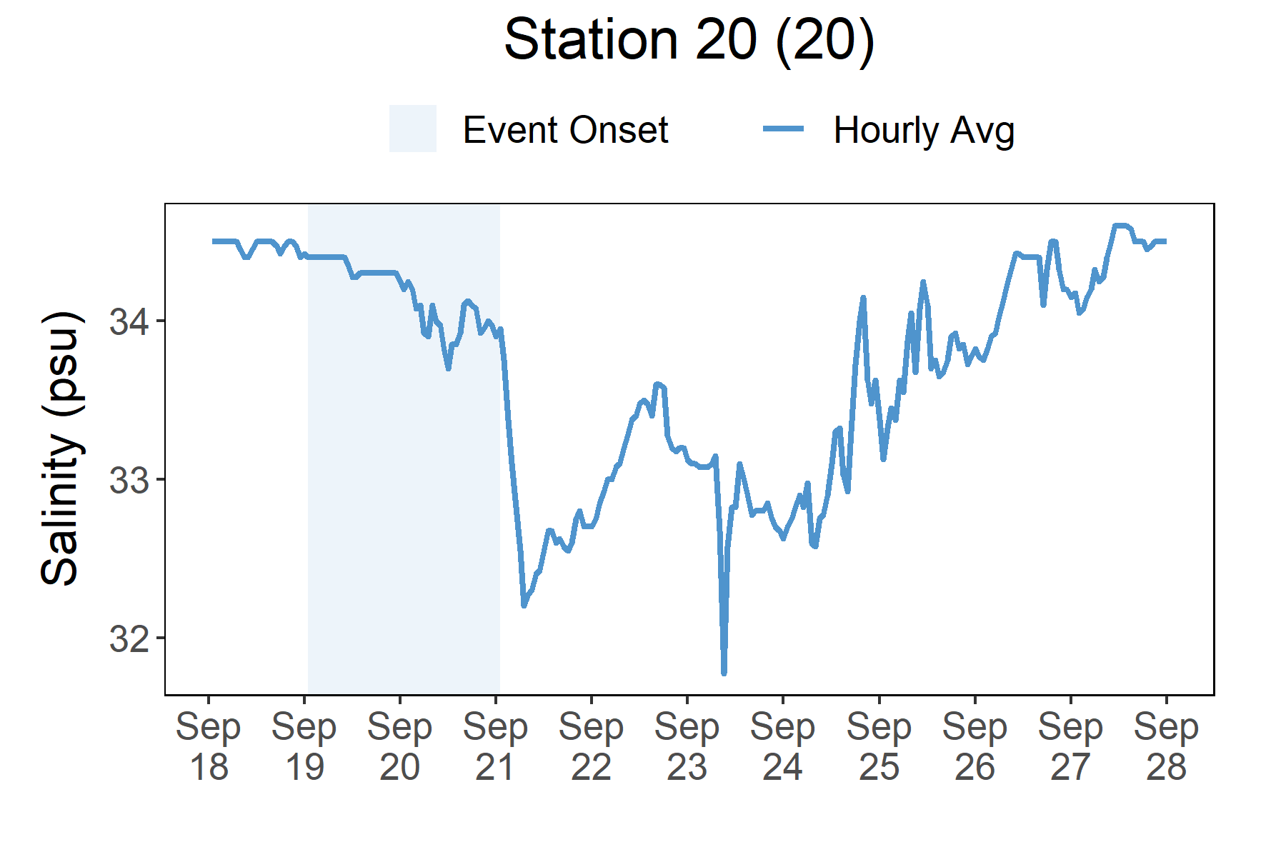
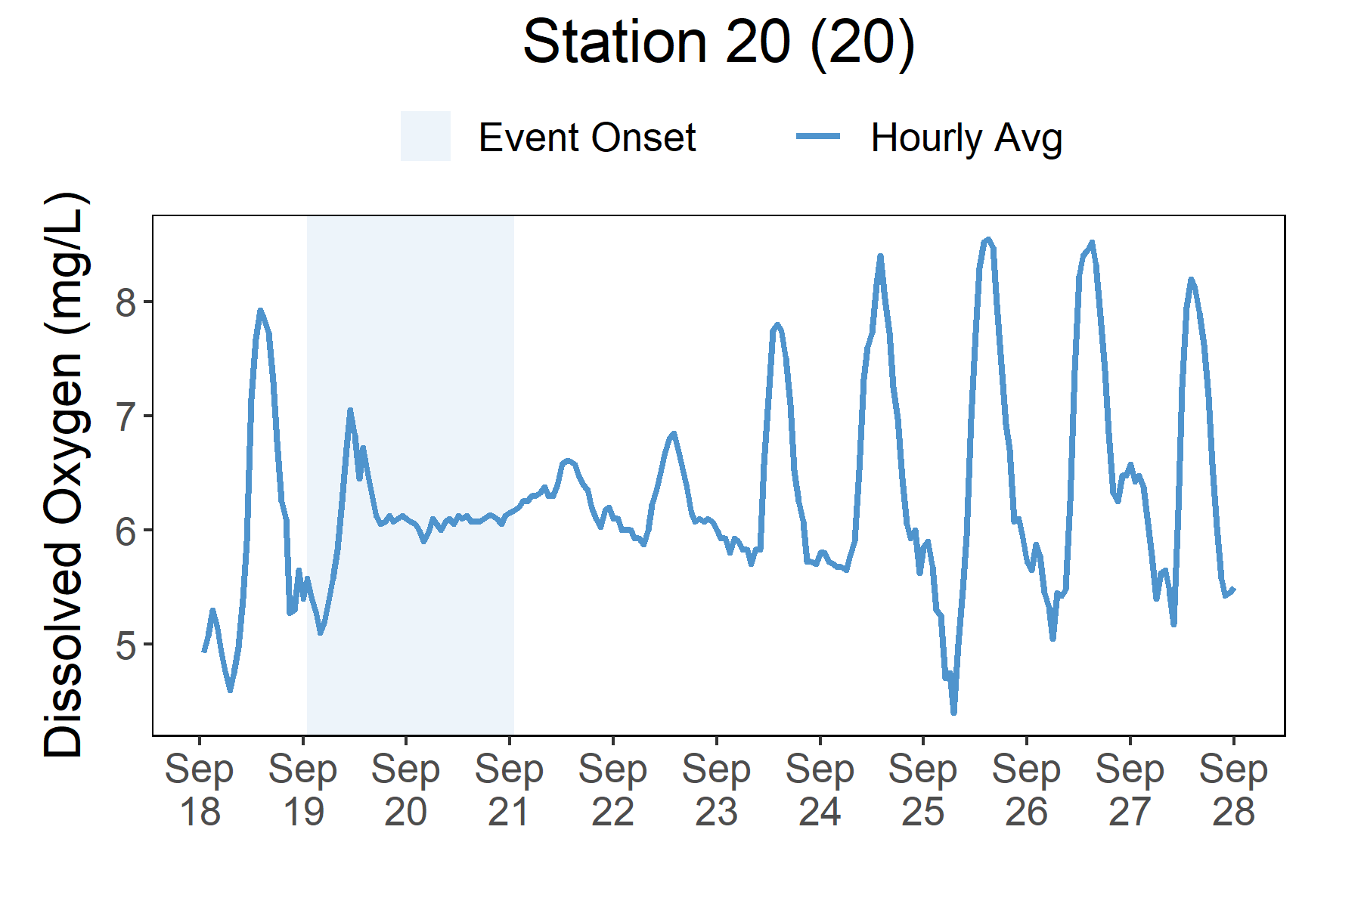
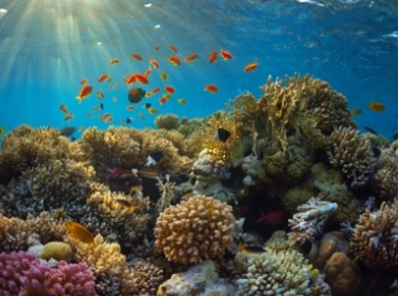
At Station 20, a dramatic spike in turbidity occurred on Sept. 20. Salinity levels gradually began dropping at the onset of Maria and experienced a rapid decline on Sept 21 after Maria had passed the island.
Station | Date | Turbidity Maximum (ft) | Salinity Minimum (psu) | Salinity Maximum (psu) | Dissolved Oxygen Minimum (mg/L) | Dissolved Oxygen Maximum (mg/L)
Station 20 | 9/19/2017 | 29 | 34.2 | 34.5 | 5.0 | 7.2
Station 20 | 9/20/2017 | 725 | 33.7 | 34.3 | 5.8 | 6.2
Station 20 | 9/21/2017 | 97 | 32.2 | 34.0 | 6.0 | 6.6
Station 20 | 9/22/2017 | 14 | 32.6 | 33.6 | 5.7 | 6.9
Station 20 | 9/23/2017 | 9 | 31.3 | 33.2 | 5.6 | 7.9
Data reporting time periods for Hurricane Maria: 9/19/2017 - 9/23/2017
Salinity
Dissolved Oxygen
A rapid drop in salinity occurred as flooding occurred after Maria
The regular diurnal cycles of dissolved oxygen were disturbed
Salinity levels from Sept. 18 to Sept. 28.
Dissolved oxygen levels from Sept. 18 to Sept. 28.
Salinity and Dissolved Oxygen levels that were recorded at the Jobos Bay NERR Station 20 show initial and post-storm impacts on water quality in this area. Salinity levels gradually dropped at the onset of the storm, and then quickly declined once Maria had passed the island. Recovery was gradual as the area experienced extreme flooding. Dissolved oxygen levels were impacted as well, and the impacts could be seen earlier at the onset of the storm. The regular diurnal cycle was compressed, and levels stayed in a lower range (< 1 mg/L) during the flooding. Dramatic changes in salinity and lower levels of oxygen can cause stress to some aquatic organisms depending on the species and how long the levels deviate from what is normal. Water quality stresses can impact survival and future populations.
Every plant and animal species have habitat preferences and requirements. Understanding these habitats is critical to understanding populations.

Slide 6
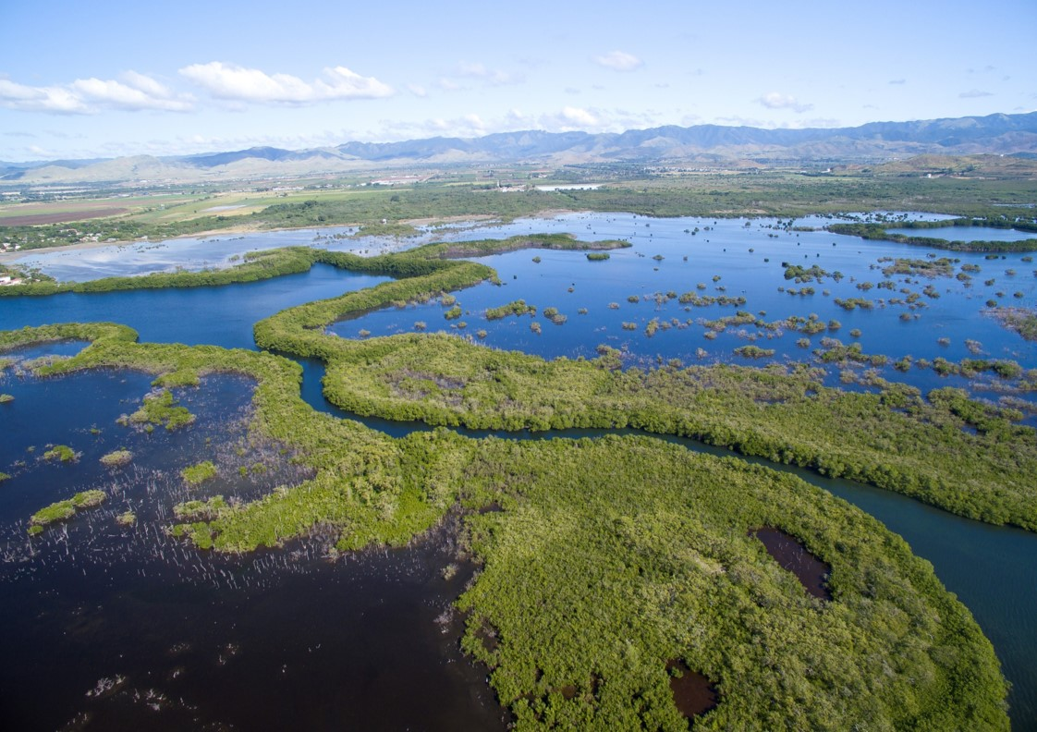
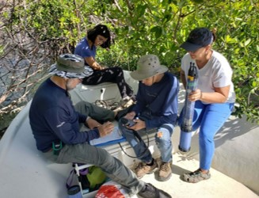
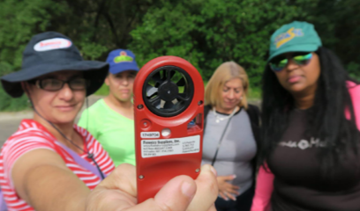
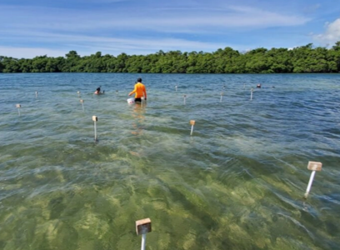
Angel Dieppa, Research and Monitoring Coordinator e: adieppa.jbnerr@gmail.com p: 787.999.2200
Visit www.nerrsdata.org to view and download weather and water quality data from Jobos Bay NERR.
Interested in learning more? Visit https://www.drna.pr.gov/jbnerr/. For video, news updates, online storm data and prediction visualization tools, check out our Storm Story Map at www.storm storymap.url.
@drnapr

